Slide 1

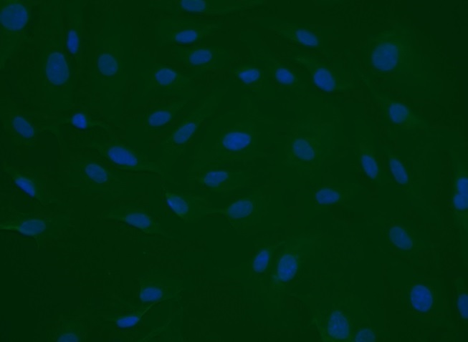
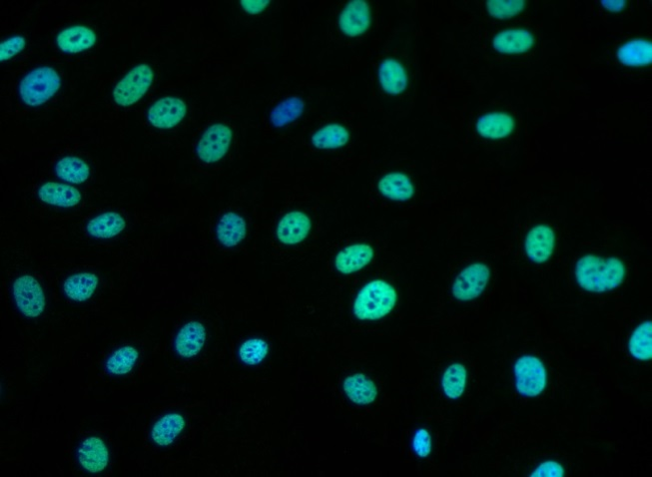
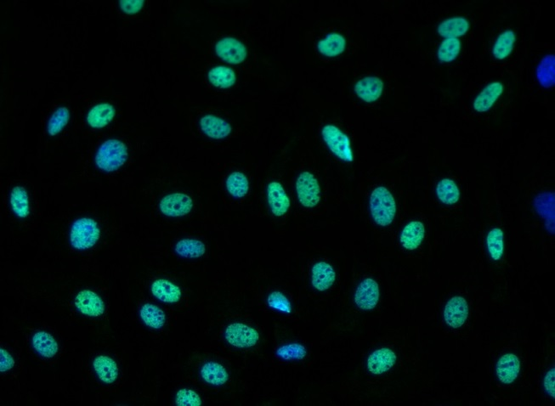
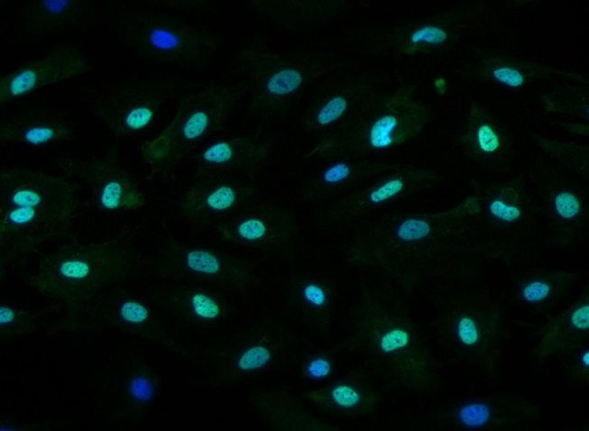
Reliatech GmbH
Anti-human Prox1 (#102-PA32AG)
(IF_LEC1402-1)
Fig. 1: Immunofluorescence staining of human Prox-1 in HUVEC.
Control: goat anti-rabbit ALEXA Flour 488 [Dianova]
Control: goat anti-rabbit ALEXA Flour 488
1µg/ml
5µg/ml
10µg/ml
http://www.reliatech.de / orders@reliatech.de

